Slide 1
MS Excel
- Asst. Prof CAMILTON J

Slide 2
What is a Spreadsheet ?
“ An electronic document in which data is arranged in the rows and columns of a grid and can be manipulated and used in calculations “

Slide 3
Top Spreadsheet Applications in the world:
Microsoft Excel for powerful data crunching and large data sets
Google Sheets for spreadsheet collaboration
LibreOffice Calc for a free, Traditional spreadsheet app
Smartsheet for project management and other non-spreadsheet tasks
Quip for integrating spreadsheets into shared documents (Salesforce)
Zoho Sheet for a free, feature-rich solution
EtherCalc for creating a collaborative spreadsheet without an account
Airtable for database management

Slide 4
MS EXCEL – Introduction
MS Excel is a spreadsheet, a grid made from columns and rows. It is a software program that can make number manipulation easy and somewhat painless.
Microsoft Excel is an example a “spreadsheet.”
Microsoft Excel is available on both PCs and Macs.

Slide 5
Basics of MS EXCEL Spreadsheet
Spreadsheets are made up of
Columns
Rows
and their intersections are called cells

Slide 6
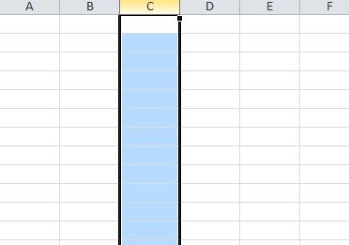
What is a COLUMN ?
In a spreadsheet the COLUMN is defined as the vertical space that is going up and down the window.
Alphabets are used to designate each COLUMN'S location.

Slide 7
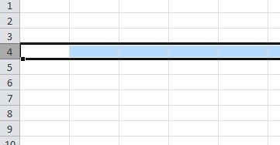
What is a Row ?
In a spreadsheet the ROW is defined as the horizontal space that is going across the window. Numbers are used to designate each ROW'S location.

Slide 8
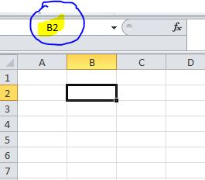
What is a CELL ?
A CELL is the space where a row and column intersect. Each CELL is assigned a name according to its COLUMN letter and ROW number.

Slide 9
Starting and Closing MS Excel
File > Exit.
All Programs > Microsoft Office > Microsoft Excel

Slide 10
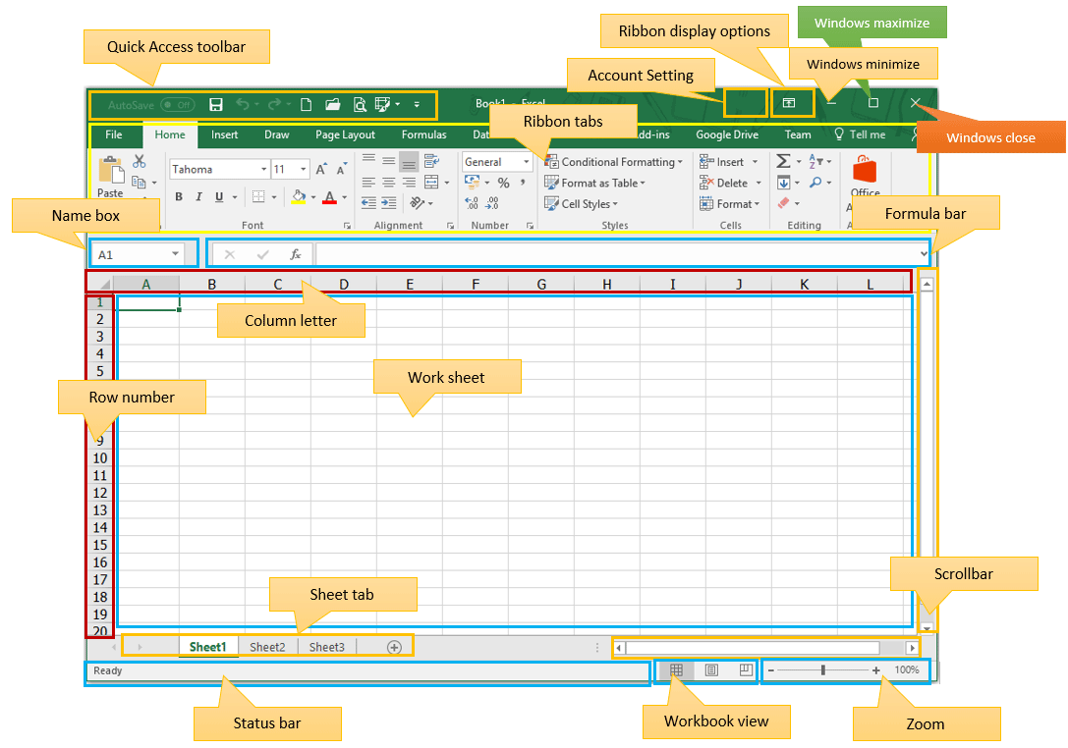
Elements of the User Interface
Tab

Slide 11
Title Bar
The Title Bar This is a close-up view of the Title Bar, where file information is located. It shows the name of the file (here, “Book1,” the default title) and the name of the program (“Microsoft Excel”). You will be able to name your file something new the first time that you save it. Notice the three buttons on the right side of the Title Bar, controlling the size and closing of the program.

Slide 12
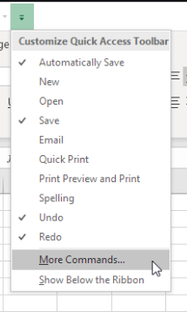
Quick Access Toolbar
Quick Access Toolbar On the top left-hand side of the Title Bar, you will see several little icons above the File menu. These let you perform common tasks, such as saving and undoing, without having to find them in a menu. We’ll go over the meanings of the icons a little later.

Slide 13
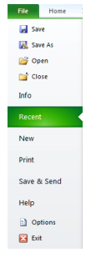
File Menu
In Microsoft Office 2007, there was something called the Microsoft Office Button in the top left-hand corner.
In Microsoft Office 2010, this has been replaced with a tab in the Ribbon called “File.” When you left-click on this tab, a drop-down menu appears. From this menu, you can perform the same functions as were found under the Microsoft Office Button menu, such as: Create a new worksheet, open existing files, save files in a variety of ways, and print.

Slide 14
Home Tab
The Home Tab Toolbar offers options that can change the font, size, color, alignment, organization and style of the text in the spreadsheet and individual cells. For example, the “Calibri” indicates the FONT of your text, the “11” indicates the SIZE of your text; etc. We will go over how to use all of these options to format your text in a little while.

Slide 15
Formula Bar
The Formula Bar is generally found below the ribbon menu. The left side denotes which cell is selected (“C5”) and the right side allows you to input equations or text into the selected cell.

Slide 16
Selection and navigation
Navigating within a worksheet
Using the mouse:
Use the vertical and horizontal scroll bars if you want to move to an area of the screen that is not currently visible. To move to a different worksheet, just click on the tab below the worksheet.
Using the keyboard:
Use the arrow keys, or [PAGE UP] and [PAGE DOWN], to move to a different area of the screen. [CTRL] + [HOME} will take you to cell A1. [CTRL] + [PAGE DOWN] will take you to the next worksheet, or use [CTRL] + [PAGE UP] for the preceding worksheet. You can jump quickly to a specific cell by pressing [F5] and typing in the cell address. You can also type the cell address in the name box above column A, and press [ENTER]

Slide 17
Selecting cells
Using the mouse:
Click on a cell to select it. You can select a range of adjacent cells by clicking on the first one, and then dragging the mouse over the others. You can select a set of non-adjacent cells by clicking on the first one, and then holding down the [CTRL] key as you click on the others.
Using the keyboard:
Use the arrow keys to move to the desired cell, which is automatically selected. To select multiple cells, hold down the [SHIFT] key while the first cell is active, and then use the arrow keys to select the rest of the range.

Slide 18
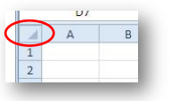
Selecting rows or columns
To select all the cells in a particular row, just click on the row number (1, 2, 3, etc.) at the left edge of the worksheet. Hold down the mouse button and drag across row numbers to select multiple adjacent rows. Hold down [CTRL] if you want to select a set of non-adjacent rows.
Similarly, to select all the cells in column, you should click on the column heading (A, B, C, etc.) at the top edge of the worksheet. Hold down the mouse button and drag across column headings to select multiple adjacent columns. Hold down [CTRL] if you want to select a set of non-adjacent columns.
You can quickly select all the cells in a worksheet by clicking the square to the immediate left of the Column A heading (just above the label for Row 1).
To select the entire worksheet you can also press [CTRL] + [A].

Slide 19
Types of data
In each cell there may be the following data types:
Labels -- (text with no numerical value)
Number data (constant values)
Formulas (mathematical equation used to calculate)

Slide 20
Entering Data :
Data entry cell by cell To enter either numbers or text:
Click on the cell where you want the data to be stored, so that the cell becomes active.
Type the number or text.
3. Press [ENTER] to move to the next row, or [TAB] to move to the next column. Until you’ve pressed [ENTER] or [TAB], you can cancel the data entry by pressing [ESC].

Slide 21
Deleting data
You want to delete data that’s already been entered in a worksheet? Simple!
Select the cell or cells containing data to be deleted.
2. Press the [DELETE] key on your keyboard.
3. The cells remain in the same position as before, but their contents are deleted.

Slide 22
Moving data
You’ve already entered some data, and want to move it to a different area on the worksheet?
Select the cells you want to move (they will become highlighted).
Move the cursor to the border of the highlighted cells. When the cursor changes from a white cross to a four-headed arrow (the move pointer), hold down the left mouse button.
Drag the selected cells to a new area of the worksheet, then release the mouse button.
You can also cut the selected data using the cut option on the Home tab or [CTRL] + [X]. Then click in the top left cell of the destination area and paste the data with paste option or [CTRL] + [V].

Slide 23
Copying data (CTRL + C)
Copying data To copy existing cell contents to another area on the worksheet:
1. Select the cells you want to copy (they will become highlighted).
2. Move the cursor to the border of the highlighted cells while holding down the [CTRL] key. When the cursor changes from a white cross to a hollow left-pointing arrow (the copy pointer), hold down the left mouse button.
3. Drag the selected cells to a second area of the worksheet, then release the mouse button.
You can also copy the selected data using the copy option on the Home tab or [CTRL] + [C]. Then click in the top left cell of the destination area and paste the data with the paste option or [CTRL] + [V].

Slide 24
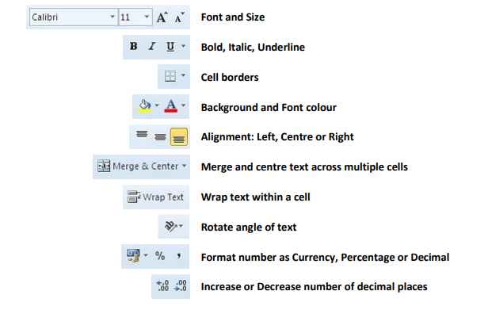
Formatting Data : Cell formatting
The icons on the Home tab provide you with a variety of formatting options. To apply any of these, just select the cell or cells that you want to format, and then click the desired icon. Commonly used formatting attributes include:

Slide 25
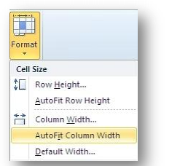
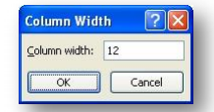
Formatting rows and columns
To manually adjust the width, click and drag the boundary between two column headings.
To automatically adjust the width, select the required columns, and then in the Cell group on the Home tab, select Format > Cell Size > AutoFit Column Width
To specify an exact column width, select the columns, and then in the Cell group on the Home tab, select Format > Cell Size > Column Width, and type the value you want

Slide 26
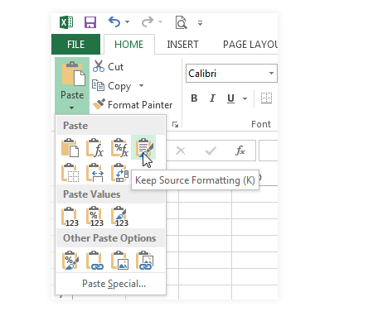
Paste Special

Slide 27
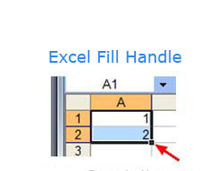
Fill handle
In Microsoft Excel, a fill handle is a feature to extend (and fill) a series of numbers, dates, or even text to a desired number of cells. In the active cell of the spreadsheet, the fill handle is a small black box at the bottom right corner, as shown in the image.
If you enter the number "1" in cell A1 and the number "2" in cell A2, you could extend that numbering sequence down through as many cells as you want.

Slide 28
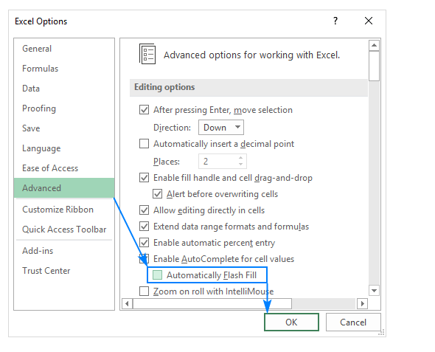
What is Flash Fill in Excel?
Excel Flash Fill is a special tool that analyzes the information you are entering and automatically fills data when it identifies a pattern.

Slide 29
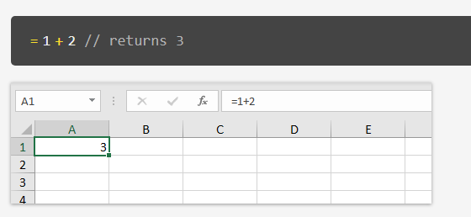
Create formulas
A formula in Excel is an expression that returns a specific result. For example:
=1+2 // returns 3

Slide 30
Create formulas
Cell references
In the examples above, values are "hardcoded". That means results won't change unless you edit the formula again and change a value manually. Generally, this is considered bad form, because it hides information and makes it harder to maintain a spreadsheet.
Instead, use cell references so values can be changed at any time.
In the screen below, C1 contains the following formula:

Slide 31
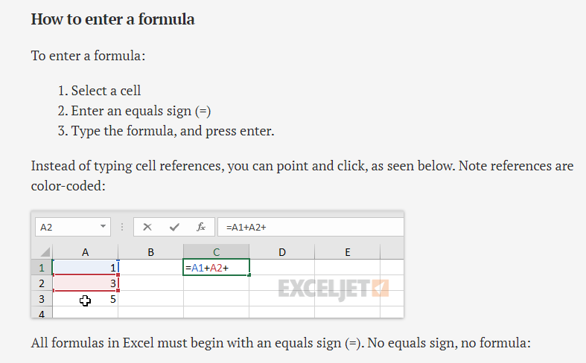

Slide 32
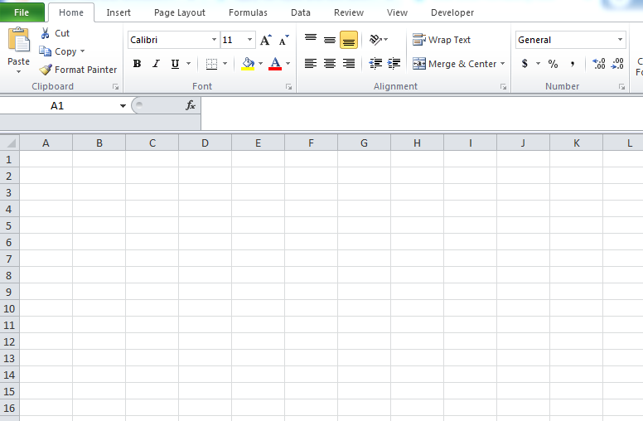
Apply cell styles and font commands, apply number and date formats.

Slide 33
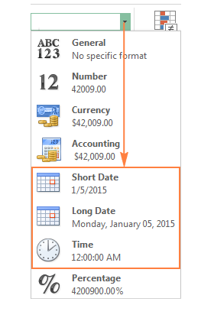
Apply cell styles and font commands, apply number and date formats.

Slide 34
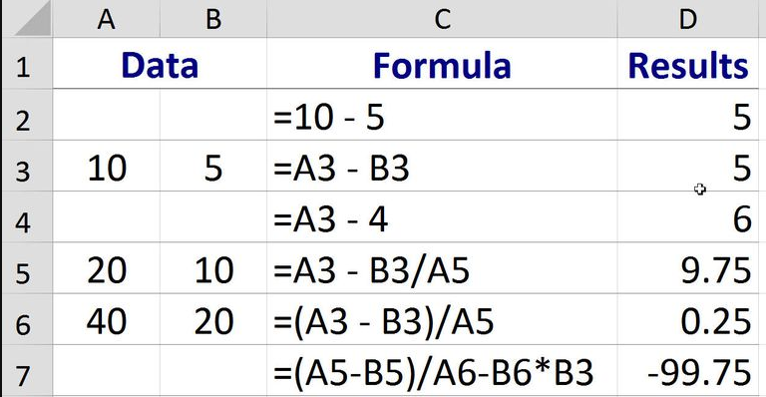
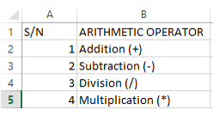
Build addition, subtraction, multiplication and division formulas.

Slide 35
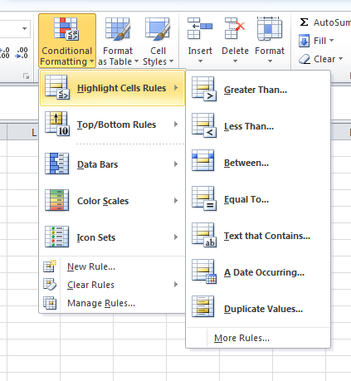
Set highlight cell rules.

Slide 36
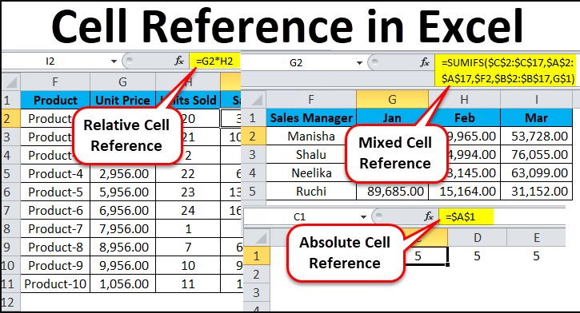
Use relative, absolute, and mixed references.

Slide 37
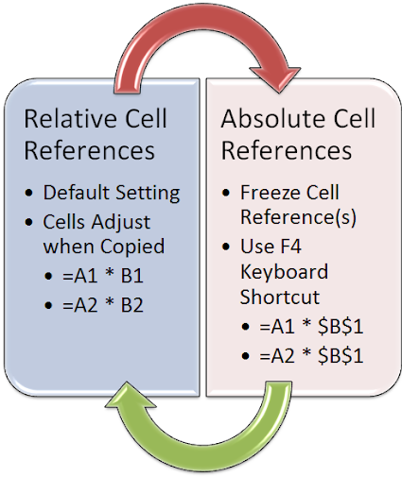
Use relative, absolute, and mixed references.

Slide 38
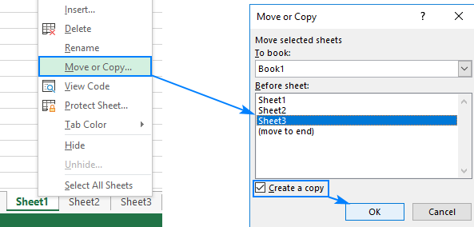
Copy worksheets

Slide 39
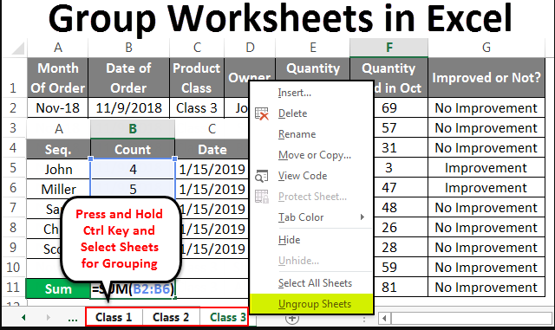
Group worksheets

Slide 40
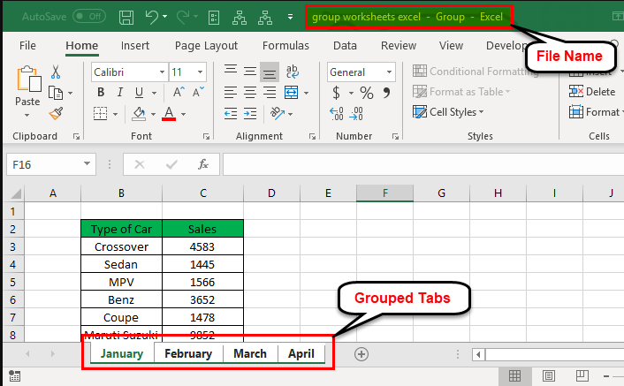
Group worksheets

Slide 41
Commonly used MS Excel Functions

Slide 42
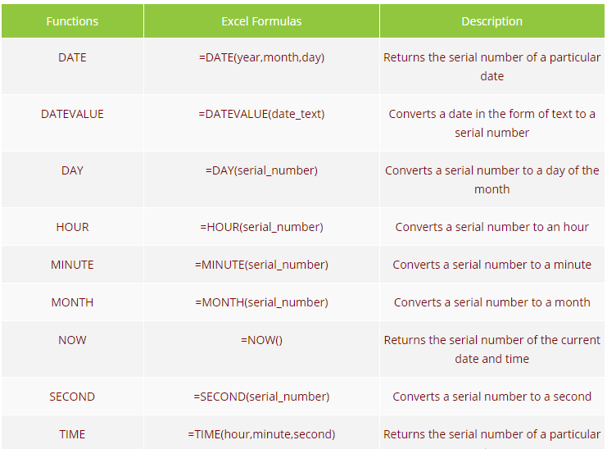

Slide 45
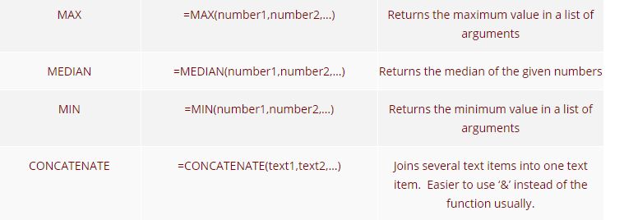

Slide 46
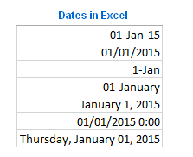
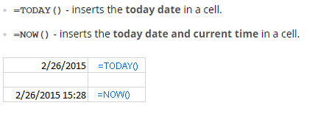
Entering dates.

Slide 47
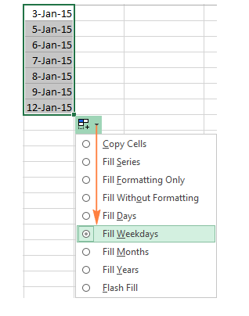
Entering dates.

Slide 48
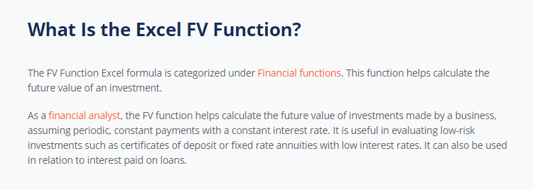
Financial Functions

Slide 49
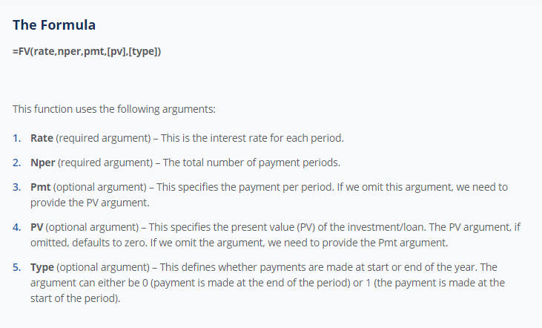

Slide 50
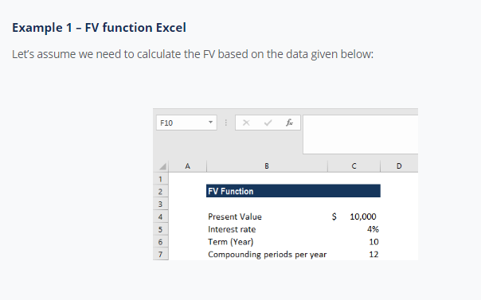
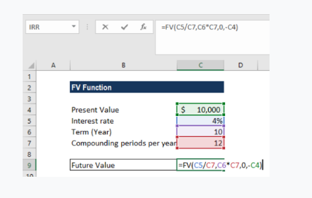

Slide 52
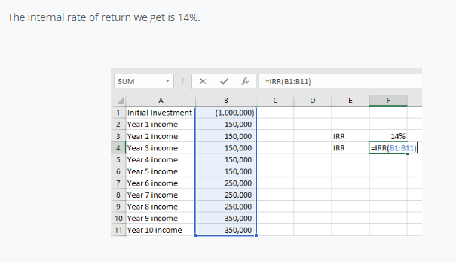

Slide 55
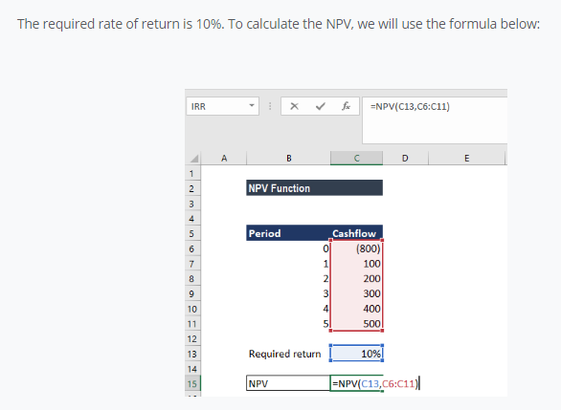
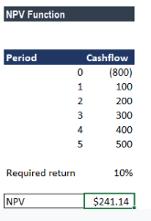

Slide 58
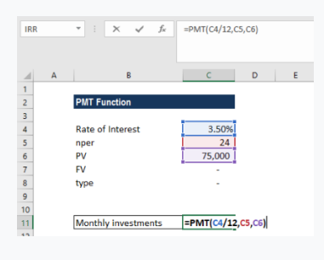
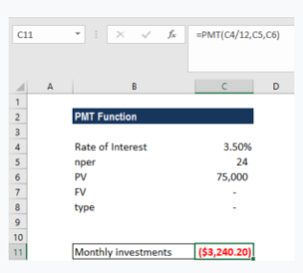

Slide 60
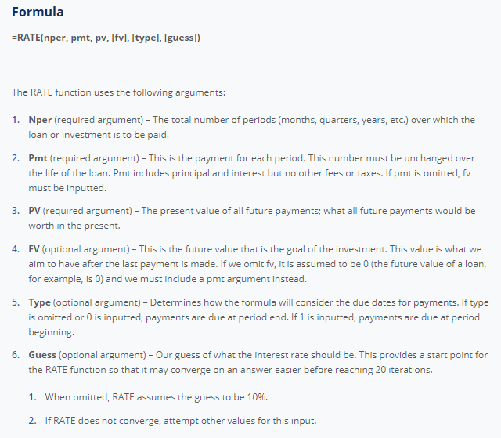

Slide 61
